Slide 1


Airbnb NYC Market Analysis
Pricing Strategy, Demand Patterns & Host Performance Analysis
Project Done By:
Sankalp Singh

Slide 2
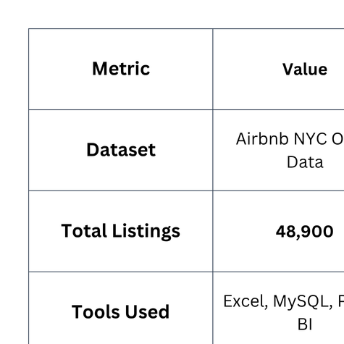
Executive Summary
This project analyzes 48,900 Airbnb listings across New York City to understand how pricing, location, room type, host behavior, and customer reviews influence occupancy and estimated revenue.
Using Excel for data cleaning, MySQL for business analysis, and Power BI for interactive visualization, the project identifies market trends, evaluates host performance, and uncovers high-potential investment opportunities. The insights help hosts optimize pricing strategies, improve booking performance, and make informed decisions in a highly competitive short-term rental market.
Business Value
Improve pricing strategies to maximize occupancy.
Identify profitable neighborhoods and market opportunities.
Evaluate host performance and customer booking patterns.
Support data-driven decision-making through actionable insights.

Slide 3
Problem Statement
New York City has approximately 49,000 Airbnb listings, making it one of the world's most competitive short-term rental markets.
With thousands of hosts competing for travelers, it has become increasingly difficult to answer questions such as:
What is the ideal nightly price?
Which neighborhoods are most profitable?
Which room type performs best?
How can hosts increase occupancy?
Where should new hosts invest?
Business Objective
The objective of this project is to analyze Airbnb listing, pricing, review, availability, and host data to identify the key factors influencing listing success and provide actionable recommendations that help hosts maximize revenue while improving marketplace efficiency.

Slide 4
Dataset Overview
Dataset Information
Source
Total Records
Key Features
Listing Name
Host Information
Borough
Neighborhood
Room Type
Price
Availability
Minimum Stay
Reviews
Last Review Date
Airbnb NYC Open Data
Approximately 48,900 Listings
Why These Tools?
Excel (Data Cleaning & Preparation) | MySQL (Business Analysis) | Power BI (Dashboard & Visualization)

Slide 5
Business Questions
Business Questions Answered
Which borough has the highest number of listings?
Which borough has the highest average price?
Which room type generates the highest revenue?
Which neighborhoods generate the highest annual revenue?
Do reviews influence occupancy?
Which pricing strategy maximizes bookings?
Do professional hosts outperform individuals?
Does minimum stay affect demand?
Who are the top-performing hosts?
How has Airbnb demand changed over time?

Slide 6
Market Overview
Borough Performance
Key Findings
Brooklyn contains 20,104 Listings making it the largest Airbnb market in NYC.
Manhattan has the highest average nightly price $196.88 because of strong tourist demand and premium locations.
Room Type Analysis
Entire Home/Apartments
Highest Average Price
Private Rooms
Highest Booking Frequency
Business Insight
High supply exists in Brooklyn, while Manhattan remains the premium pricing market.

Slide 7
Pricing & Revenue
Revenue Analysis
Pricing Strategy
Highest Revenue Neighborhood
Woodrow
(Staten Island)
Estimated Annual Revenue
$255,500
The Mid Price Band
($50–150) achieves
262 Average Booked Days per Year making it the pricing sweet spot.
Business Insight
Mid-priced listings balance affordability and profitability, generating the strongest occupancy.

Slide 8
Host Performance
Professional vs Individual Hosts
Key Findings
Professional Hosts
Charge 41% higher nightly prices
Top Host
Sally
Estimated Portfolio Revenue $10,187,176 per year
Individual Hosts
Generate approximately 1.9× higher revenue per listing
Receive nearly 3× more reviews
Maintain lower availability, indicating stronger occupancy
Business Insight
Individual hosts achieve better performance on a per-listing basis despite charging lower prices.

Slide 9
Customer Behavior
Customer Booking Patterns
Review Analysis
Minimum Stay Analysis
Listings with 100+ Reviews Average 178 Available Days.
Listings with No Reviews Average 105 Available Days
Listings requiring
1–3 Night Stay
receive significantly more reviews than listings requiring 7+ nights.
Business Insight
Flexible booking policies encourage higher customer demand.

Slide 10
Market Opportunities
Underserved Neighborhoods
Several neighborhoods have relatively few listings while maintaining premium prices.
High-Potential Areas
Why These Markets?
DUMBO
Vinegar Hill
Jamaica Estates
City Island
Low Competition
High Nightly Prices
Strong Demand
Opportunity for New Hosts
Business Insight
Hosts entering underserved neighborhoods can achieve premium pricing with less competition.

Slide 11
Market Opportunities
Interactive Power BI Dashboard
Dashboard KPIs
The dashboard enables stakeholders to explore:
Revenue Performance
Pricing Analysis
Borough Comparison
Host Performance
Customer Reviews
Occupancy Trends
Neighborhood Analysis
Total Listings
Average Price
Estimated Revenue
Average Reviews
Occupancy Estimate
About Page
Market Overview
Host & Pricing Strategy

Slide 12
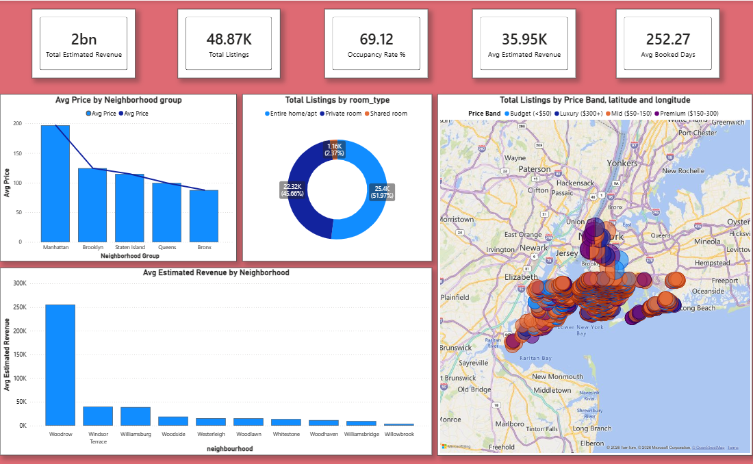

Slide 13
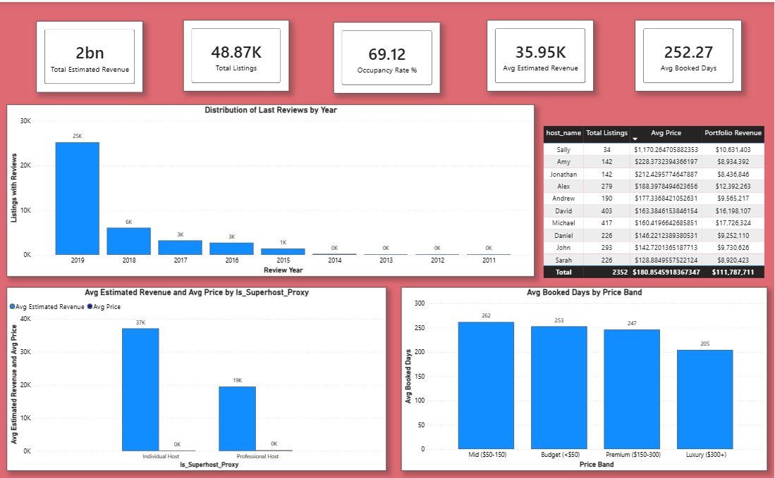

Slide 14

Key Findings
Major Insights
✔ Brooklyn dominates the market by listings.
✔ Manhattan commands the highest prices.
✔ Entire Home listings earn the highest nightly rates.
✔ Mid-priced properties maximize occupancy.
✔ Individual hosts outperform professionals.
✔ Flexible minimum stays increase demand.
✔ Review activity peaked in 2019.
✔ Several premium neighborhoods remain underserved.

Slide 15
Conclusion
Project Summary
This project analyzed approximately 48,900 Airbnb listings to understand pricing strategies, demand patterns, host performance, and market opportunities across New York City.
Using Excel, MySQL, and Power BI, the analysis identified the factors that drive occupancy and revenue while uncovering actionable insights for hosts and stakeholders.
Key Takeaways
Data-driven pricing improves occupancy.
Mid-priced listings perform best.
Individual hosts achieve higher revenue per listing.
Flexible booking policies increase customer engagement.
Underserved neighborhoods provide strong expansion opportunities.

Slide 16
Thank You
Questions & Discussion
Thank you for your attention.
I hope this presentation has demonstrated not only my technical skills in Excel, MySQL, and Power BI, but also my ability to translate data into meaningful business insights and actionable recommendations.
I welcome your questions, feedback, and suggestions.
Presented By
Sankalp Singh
EMAIL ADDRESS
connect.sankalpsingh@gmail.com
LinkedIn
linkedin.com/in/sankalp-singh-ranaut/
GitHub
github.com/SankalpSinghRanaut

